Slide 1

Human Activity Identification
Presented by:
Student Name Roll No
Neha Marne B150234313
Isshita Paliwal B150234272
Akansha Jagtap B150234277
Guided By:
Mr. M.P. Wankhede

Slide 2
Outline
Introduction
Motivation
Problem statement
Objectives
Software and hardware requirement
Literature Survey
Proposed Algorithm
System Architecture
Data flow diagram
UML diagram
Results & Discussion
Future Scope
Conclusion
References

Slide 3
Introduction
Human activity recognition plays a significant role in human-to-human interaction and interpersonal relations. The human ability to recognize another person's activities is one of the main subjects of study of the scientific areas of computer vision and machine learning.
This technology has the potential to be used in automated activity profiling systems which produce a continuous record of activity patterns over extended periods of time.
It will mainly be used for eldercare and healthcare as an assistive technology when ensemble with other technologies likes Internet of Things (IoT).
HAR can be done with the help of sensors, smartphones or images. Activity recognition is used in many applications such as surveillance, anti-terrorists, and anti-crime securities as well as life logging and assistance.

Slide 4
Motivation
Human activity recognition basis for many applications such as video surveillance, health care, and human-computer interaction.
To Analyse the activity of a person from the information collected by different devices. Discover which are the variables that determine which activity is doing a person.
To Calculate a predictive model that can recognize a person's activity.

Slide 5
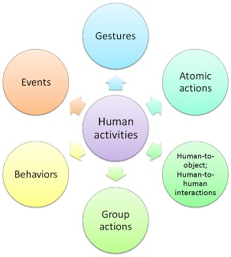
Problem statement
Human Activity Recognition is the problem of predicting what a person is doing based on a trace of their movement .
The aim is to build a software that will recognize human activities. We can also predict actions using already recoded videos as well as using live footage.

Slide 6
Objectives
To identify a method achieving more accurate human activity recognition by using suitable tools and to recommend effective methods for the most cost-effective human activity recognition.
To propose a mechanism of an automated analysis or interpretation of ongoing events and their context from video data.
To explore better approach for action recognition based on using the suitable types of data to balance the use of features by strengthen the weak part in each type by the strong part in the other.
This project will analyze the activity being performed by the user in the Video input. Human activity recognition will use Pose estimation and classification algorithm to analyze the data set and detect the activity

Slide 7
Software and Hardware Requirements
Software Requirement:
Operating System: Windows 10
Programming Language:Python
IDE: VS Code
Framework: Django
Hardware Requirement:
Processor: Intel Core I5
RAM: 8 GB or Higher
HardDisk: 500 GB

Slide 8
Literature Survey
Sr.no | Title | Author | Abstract
1 | Human motion analysis: A review. | Aggarwal and Cai (1999) | Human motion analysis, tracking from single view and multiview cameras, and recognition of human activities.
2 | A survey of advances in vision-based human motion capture and analysis | Moeslund et al. (2006) | Mainly focused on pose-based action recognition methods and proposed a fourfold taxonomy, including initialization of human motion, tracking, pose estimation, and recognition methods.

Slide 9
Sr.no | Title | Author | Abstract
3 | Deep Convolutional Neural Networks for Human Action Recognition Using Depth Maps and Postures | Aouaidjia Kamel, Bin Sheng, Po Yang, Ping L, Ruimin Shen, David Dagan Feng(2018) | Presented a method (Action-Fusion) for human action recognition from depth maps and posture data using convolutional neural networks (CNNs).
4 | Exploiting temporal information for 3D human pose estimation | Mir Rayat Imtiaz Hossain, James J. Little(2018) | Utilize the temporal information across a sequence of 2D joint locations to estimate a sequence of 3D poses. We designed a sequence-to-sequence network composed of layer-normalized LSTM units with shortcut connections connecting the input to the output on the decoder side and imposed temporal smoothness constraint during training.

Slide 10
Sr.no | Title | Author | Abstract
5 | Efficient Frequency Domain Feature Extraction Model using EPS and LDA for Human Activity Recognition | Rasel Ahmed Bhuiyan, Nadeem Ahmed (2020) | Enveloped Power Spectrum (EPS) is used for extracting impulse components of the signal, and the Linear Discriminant Analysis (LDA) is used as a dimensionality reduction procedure to extract the discriminant features for human daily activity recognition. After completing EPS feature extraction techniques, LDA is performed on those extracted spectra for extracting features using the dimension reduction technique. Finally, the discriminant vocabulary vector is trained by the Multiclass Support Vector Machine (MCSVM) to classify human activities
6 | Human Activity Recognition Using Pose Estimation and Machine Learning Algorithm | Abhay Gupta, Kuldeep Gupta, Kshama Gupta and Kapil Gupta(2021) | A single person poses estimation and activity classification using pose. Pose Estimation consists of the recognition of 18 body key points and joints locations. We have used the OpenPose library for pose estimation work. And the activity classification task is performed by using multiple logistic regression.

Slide 11
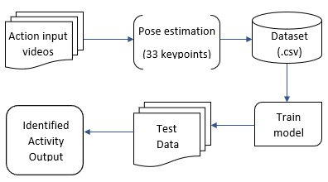
Proposed Algorithm

Slide 12
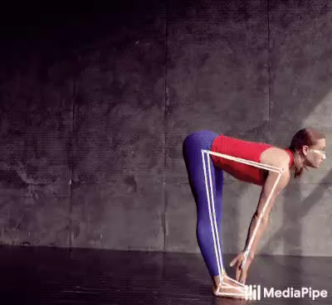
Pose Estimation:
Pose estimation is a computer vision task that infers the pose of a person or object in an image or video.
Pose estimation is the problem of determining the position and orientation of a camera relative to a given person or object.
This is typically done by identifying, locating, and tracking a number of keypoints on a given object or person. For objects, this could be corners or other significant features. And for humans, these keypoints represent major joints like an elbow or knee.

Slide 13

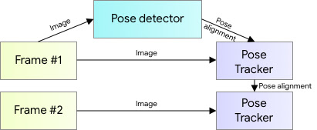
An ML Pipeline for Pose Tracking:
For pose estimation, we utilize our proven two-step detector-tracker ML pipeline. Using a detector, this pipeline first locates the pose region-of-interest (ROI) within the frame. The tracker subsequently predicts all 33 pose keypoints from this ROI.

Slide 14
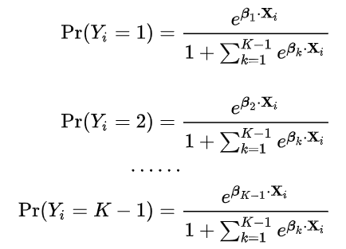
Multinomial Logistic Regression:
Multinomial logistic regression is used to predict categorical placement in or the probability of category membership on a dependent variable based on multiple independent variables.
The independent variables can be either dichotomous (i.e., binary) or continuous (i.e., interval or ratio in scale).
Multinomial logistic regression is a simple extension of binary logistic regression that allows for more than two categories of the dependent or outcome variable.

Slide 15
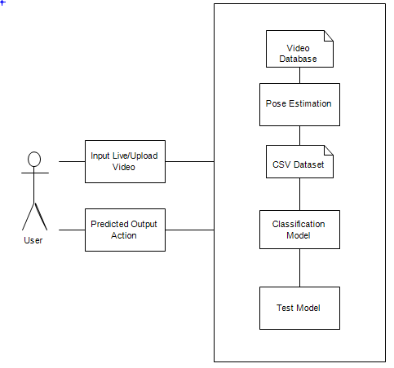
System Architecture

Slide 16
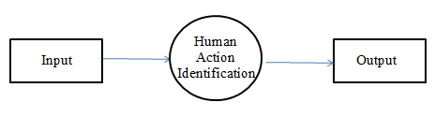
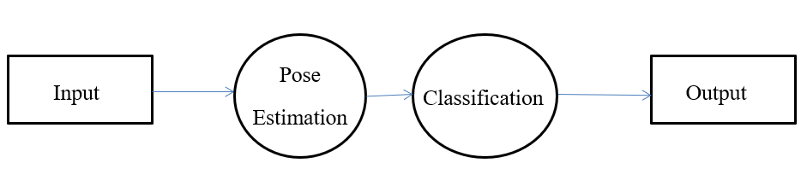
Data Flow Diagram
Level 0 :
Level 1 :

Slide 17
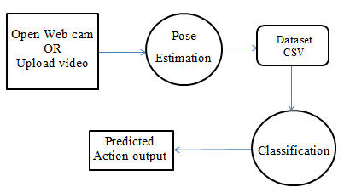
Level 2 :

Slide 18
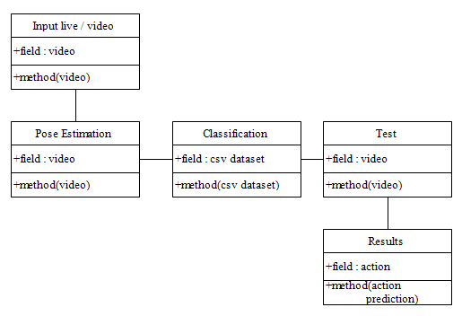
UML Diagram
Class diagram :

Slide 19
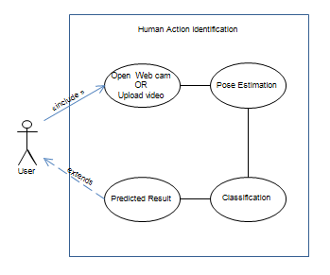
Usecase Diagram

Slide 20
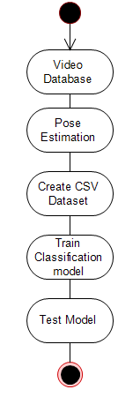
Activity Diagram

Slide 21
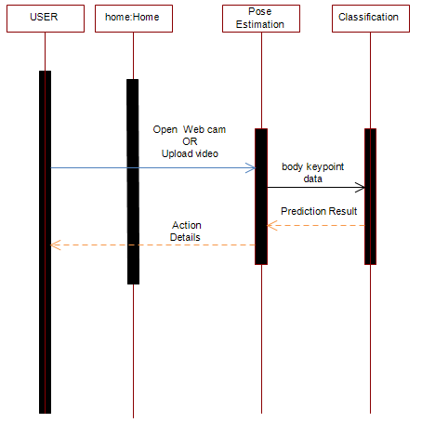
Sequence Diagram

Slide 22
Results & Discussion
We have used Logistic regression, ridge classifier, random forest classifier, gradient boosting classifier and got 100% accuracy for Logistic regression, random forest classifier, gradient boosting classifier and 99% for ridge classifier. We used logistic regression as our final model for prediction.
Algorithm | Precision | Recall | F1-Score | Support
Logistic regression | 1.0 | 1.0 | 1.0 | 651
Ridge classifier | 0.99 | 0.99 | 0.99 | 651
Random forest classifier | 1.0 | 1.0 | 1.0 | 651
Gradient boosting classifier | 1.0 | 1.0 | 1.0 | 651

Slide 23
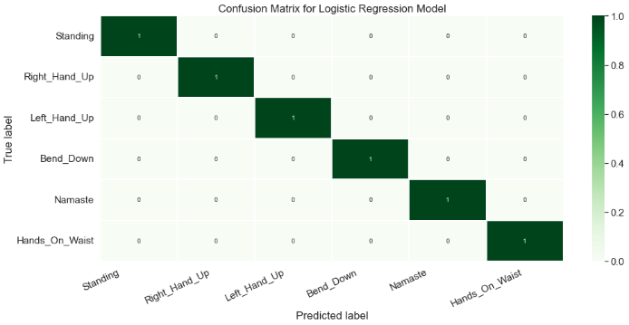

Slide 24
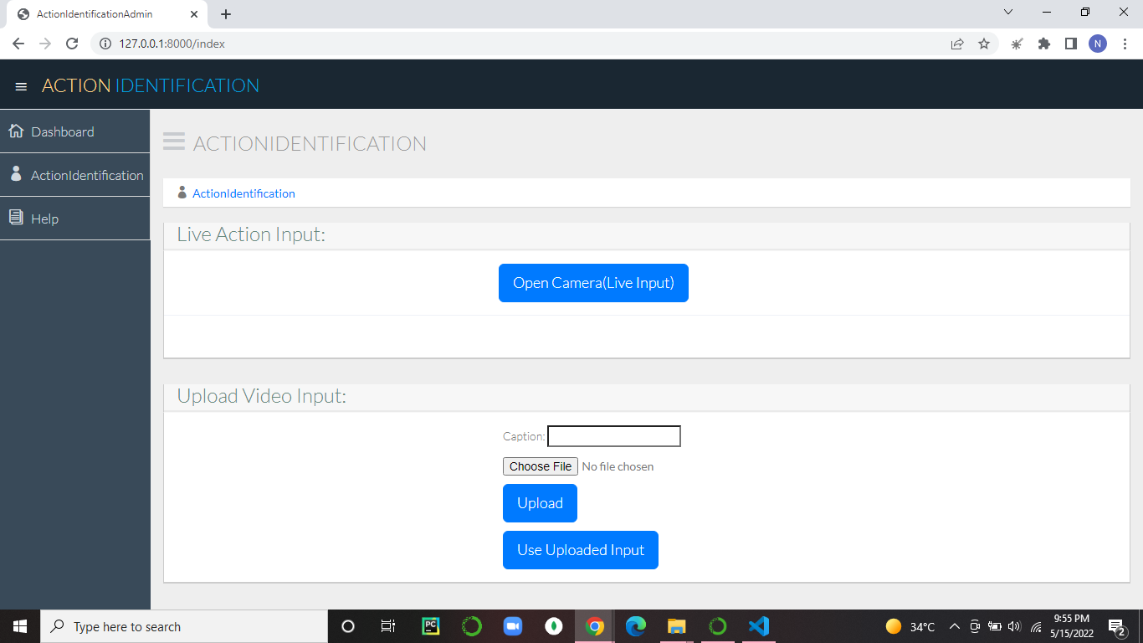

Slide 25
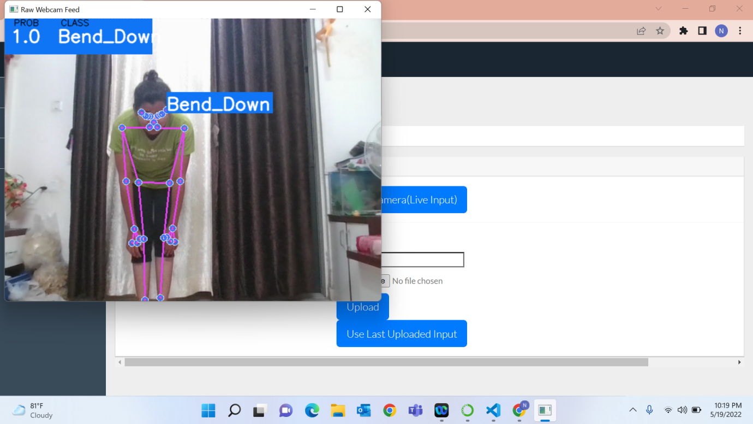
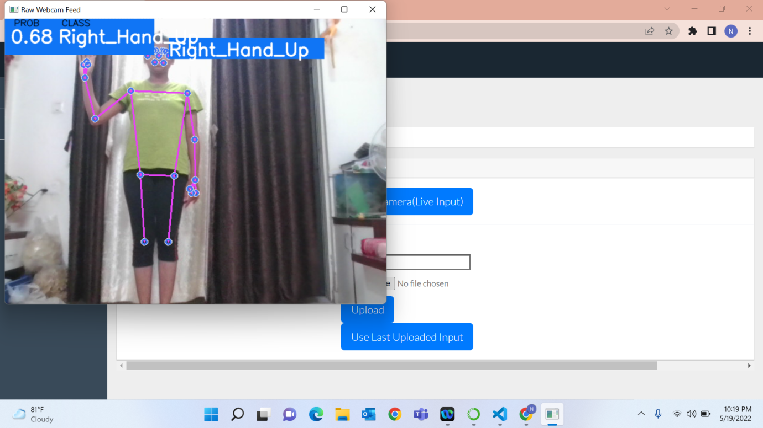
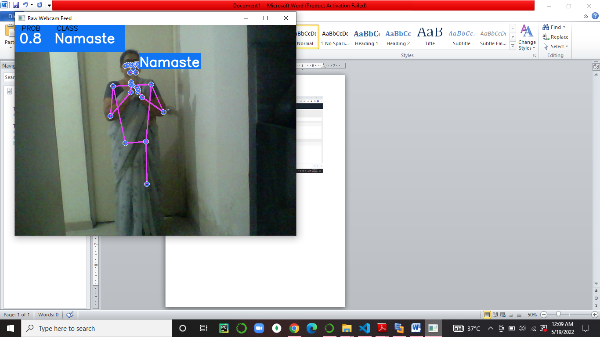
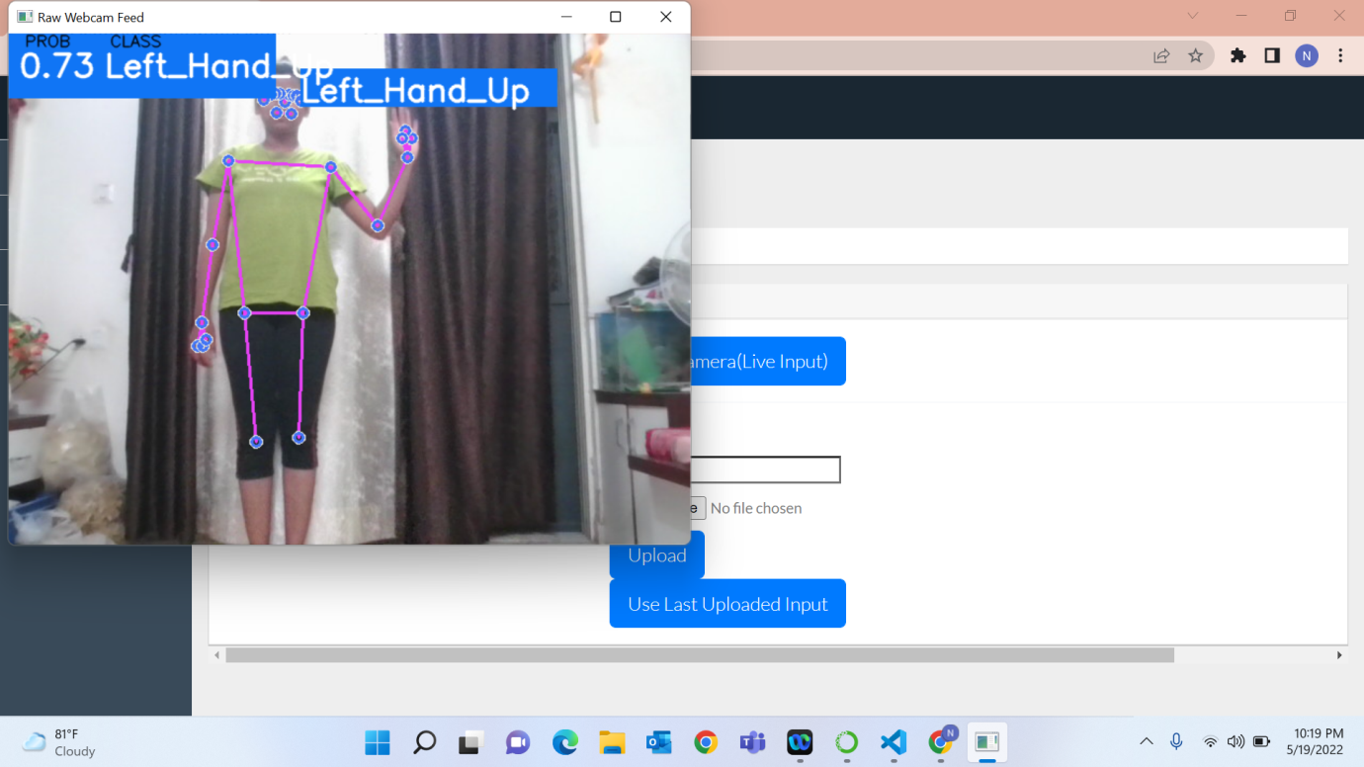
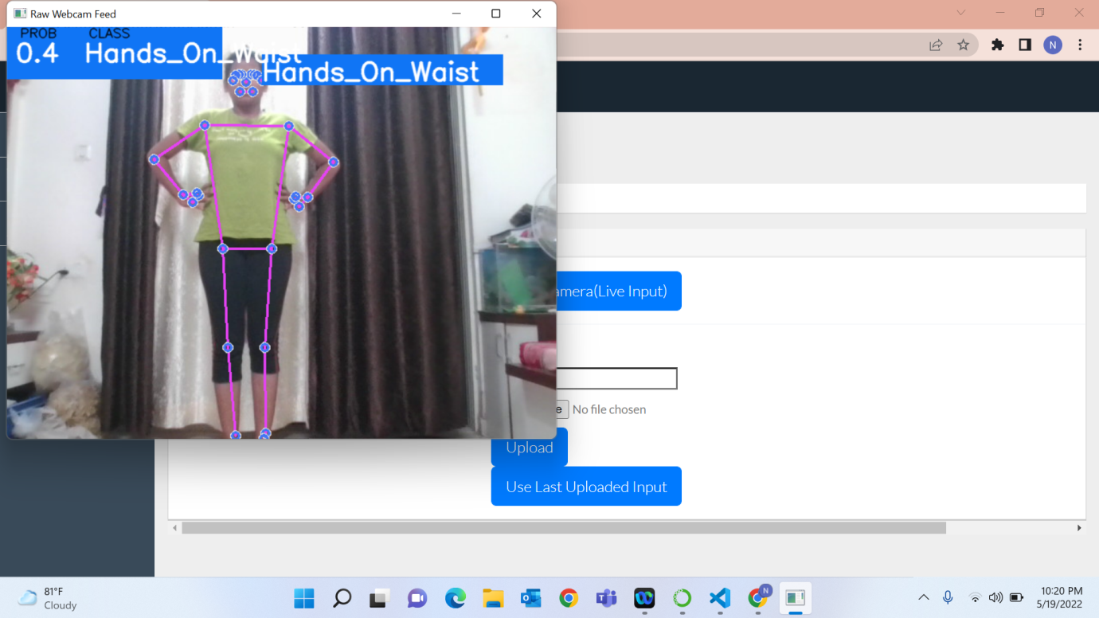
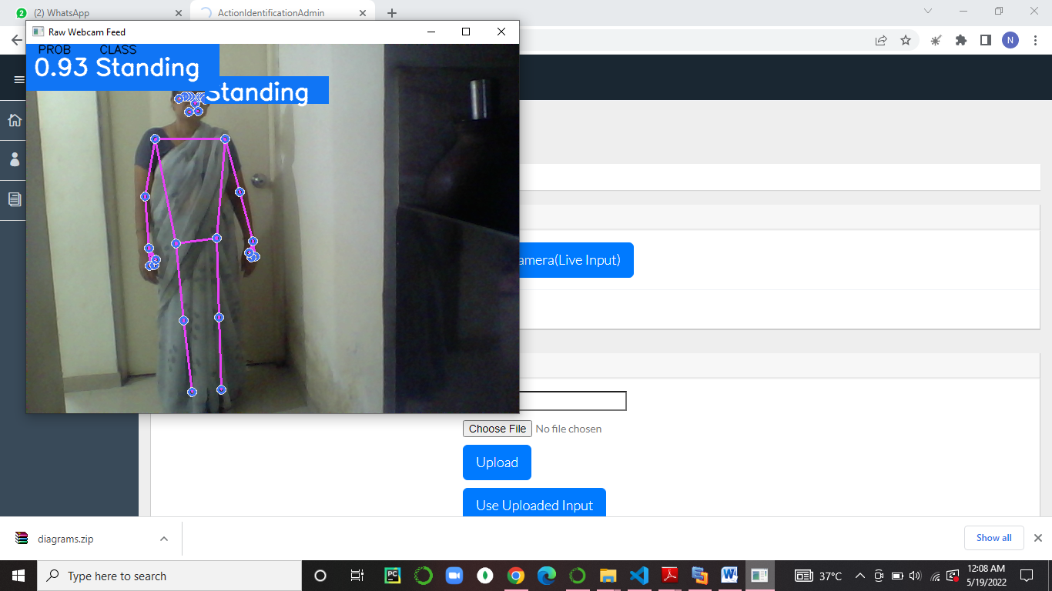

Slide 26
Timeline chart:
 |  |  | PHASE 1 |  |  |  |  | PHASE 2
ACTIVITY | START | END | SEPT | OCT | NOV | DEC | JAN | FEB | MAR | APR | MAY
Submission of project ideas. | 1/9/22 | 26/9/22
Approval of project idea. | 20/9/22 | 30/9/22
Initial Project Work Preparation | 1/10/22 | 25/11/22
First presentation about progress of project work(Review1 and Review2) | 2/12/22 | 30/12/22
Started Implementation
Selection of technology Stack | 5/1/22 | 19/1/22
Pose Estimation Logic | 15/1/22 | 10/3/22
Front-end Development | 25/2/22 | 6/5/22
Classification model | 3/4/22 | 25/4/22
Link Frontend and Backend | 10/4/22 | 15/5/22
Manual Testing | 25/3/22 | 3/4/22
Automated Testing | 3/5/22 | 16/5/22
Review 3
Presented partial implementation of project | 25/3/22 | 28/3/22
Review 4
Presented complete implementation of project | 2/5/22 | 6/5/22
Submission of report for checking
Make Revisions in Project report | 13/5/22 | 20/5/22
Final Submission of Report and Project
Submitted Black-book Report copy | 20/5/22

Slide 27
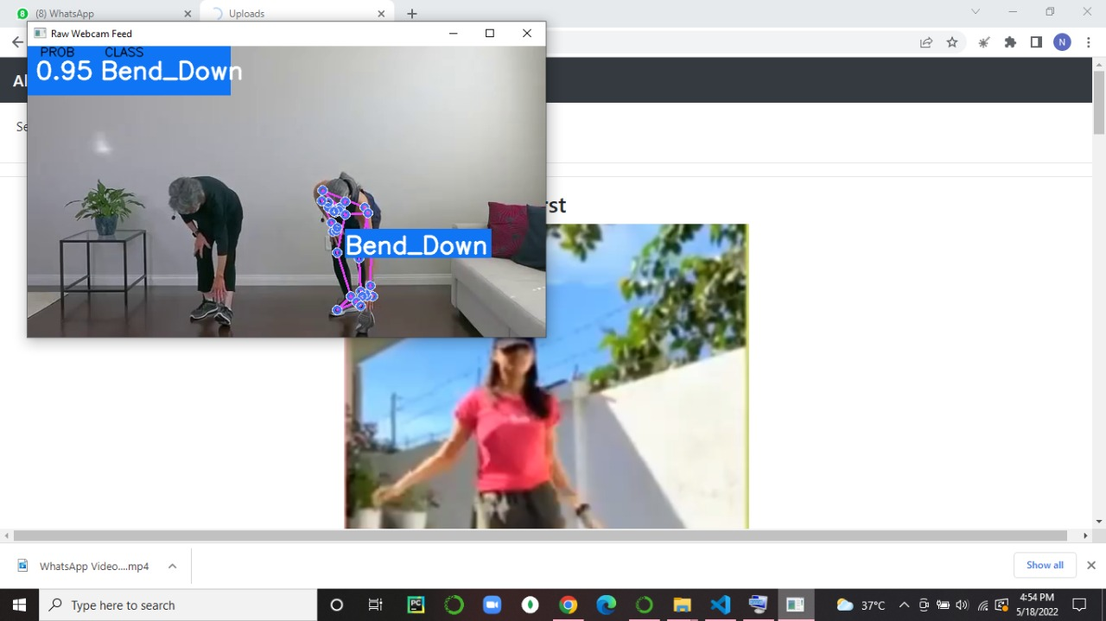
Future Scope
The project that we’ve implemented is suitable for identifying only single person in the frame. If there is more than one person it can only identify action of one person as shown below.
In future we’re planning to work upon this to identify multiple person activity in a single frame.

Slide 28
Conclusion
We have proposed a Human Activity Identification system based on pose estimation and classification algorithm.
This system will combine the results of the 3D pose estimation model with the classification algorithm for better and more accurate detailed result generation.

Slide 29
References
Aggarwal, J. K., & Cai, Q. (1999). Human motion analysis: A review. Computer vision and image understanding, 73(3), 428-440.
Kamel, A., Sheng, B., Yang, P., Li, P., Shen, R., & Feng, D. D. (2018). Deep convolutional neural networks for human action recognition using depth maps and postures. IEEE Transactions on Systems, Man, and Cybernetics: Systems, 49(9), 1806-1819.
Hossain, M. R. I., & Little, J. J. (2018). Exploiting temporal information for 3d human pose estimation. In Proceedings of the European Conference on Computer Vision (ECCV) (pp. 68-84).
H. P. S. A. Lateef and U. Eranna, "Modelling Approach to Select Potential Joints for Enhanced Action Identification of Human," 2018 International Conference on Electrical, Electronics, Communication, Computer, and Optimization Techniques (ICEECCOT), 2018, pp. 1506-1509, doi: 10.1109/ICEECCOT43722.2018.9001313.

Slide 30
R. A., Amiruzzaman, M., Ahmed, N., & Islam, M. R. (2020, August). Efficient Frequency Domain Feature Extraction Model using EPS and LDA for Human Activity Recognition. In 202020 3rd IEEE International Conference on Knowledge Innovation and Invention (ICKII) (pp. 344-347). IEEE.
Gupta, Abhay, Kuldeep Gupta, Kshama Gupta, and Kapil Gupta. "Human Activity Recognition Using Pose Estimation and Machine Learning Algorithm."

Slide 31
Thank You!

